Slide 1
IBM University Engagement Project Submission
“Exploring the Power of Agentic AI with IBM Granite and LangFlow”

Slide 2


Project Tile – [Smart Business Idea Generator Agent]
Domain of Project – [ Business]
Student Name | Recent Passport Photo | Email ID | Mobile number [WhatsApp]
Atharv Nalawade |  | nalawadeatharv800@gmail.com | 9209854887

Slide 3
Problem Statement -
Problem Statement : Business Idea Generator Agent
The Challenge
In the digital era, innovation is crucial, but individuals, students, researchers, and organizations often struggle with idea generation. Brainstorming sessions are unstructured, inspiration is scattered across articles, videos, and social media, and existing tools focus on text-only prompts without context-awareness. The challenge is not just to suggest random ideas but to synthesize creativity, context, and relevance into intelligent, actionable ideas for diverse domains such as startups, research, content creation, or product development
The Objective
Build an agentic AI Smart Idea Generator that empowers users with contextual, innovative, and multimodal ideation. The solution should:
Fuse Knowledge Sources: Pull insights from articles, research papers, trend analysis, and social platforms to generate contextual and current ideas.
Enable Multimodal Brainstorming: Accept inputs like text prompts, images (e.g., product sketches), or voice notes and refine them into structured, creative suggestions.
Create a Predictive & Agentic Layer: Identify trending domains (e.g., AI in healthcare, sustainable energy), forecast idea relevance, and recommend high-impact directions.
Visualize Idea Maps: Provide an interactive dashboard that organizes ideas into categories, impact scores, and feasibility maps, helping users explore and refine concepts quickly.

Slide 4
Proposed Solution -
Proposed Solution: AI-Powered Business Idea Generator
The Smart Business Idea Generator is a web-based application that helps aspiring entrepreneurs, students, and startup enthusiasts discover innovative business ideas based on their interests. The system uses a predefined database of business ideas categorized into different industries such as Technology, Food, Education, Health, Finance, Fashion, and Environment. Users simply select a category and the application generates a unique business idea along with useful information such as investment requirements, difficulty level, and business potential.
The application is developed using HTML, CSS, and JavaScript, making it lightweight, responsive, and easy to use without requiring any backend server or database.
Working of the System
1. The user opens the website.
2. The homepage displays different business categories.
3. The user selects a preferred category.
4. The user clicks the Generate Idea button.
5. JavaScript randomly selects a business idea from the chosen category.
6. The website displays:
- Business Name
- Description
- Estimated Investment
- Difficulty Level
- Business Potential Rating
7. The user can generate another idea anytime.

Slide 5
Technology Used
Langflow platform -For designing and orchestrating the AI workflow visually. It helps build the logic flow of the Smart Business Idea Generator using an easy drag-and-drop interface and integrates AI components seamlessly.
IBM Granite model - For generating innovative, relevant, and personalized business ideas based on user inputs. It understands natural language, performs reasoning, and provides intelligent startup recommendations.
IBM Cloud – It provides the infrastructure to build, deploy, and scale the Smart Business Idea Generator efficiently. IBM Cloud offers a reliable, secure, and scalable environment for hosting AI services and the web application.
RAG– RAG retrieves relevant business knowledge, market trends, and startup information before generating responses, making the generated business ideas more accurate, context-aware, and trustworthy.
IBM Watsonx.ai - Used for AI model deployment, prompt management, embeddings, and AI governance. It enables the integration of IBM Granite models and ensures responsible, enterprise-grade AI capabilities.
Vector Database (FAISS/Chroma) – Stores and retrieves business-related documents, startup examples, industry trends, and market insights to support RAG and improve the quality of AI-generated suggestions.

Slide 6
Langflow component Used -
1) Chat Input – Acts as the user interface where users enter their business requirements, such as industry, investment budget, skills, target audience, or startup preferences. The input is sent to the AI workflow for processing.
2) IBM watsonx AI Agent – Receives the user's request and coordinates the AI workflow. It communicates with the IBM Granite model, processes prompts, and generates intelligent, context-aware business ideas and recommendations.
3) IBM Granite Model (e.g., Granite-3.2-8B-Instruct / Granite-4.0-8B-Instruct) – Serves as the core Large Language Model (LLM). It understands user queries, performs reasoning, and generates innovative business ideas, investment suggestions, revenue models, and implementation strategies.
4) Prompt Template – Structures the user's query into a well-defined prompt before sending it to the AI model. This ensures consistent, accurate, and high-quality responses from the IBM Granite model.
5) Chat Output – Displays the AI-generated results, including the business idea, business description, estimated investment, target market, revenue model, growth opportunities, and additional startup recommendations.
6) File Component / Knowledge Base – Stores and retrieves business-related documents, startup case studies, market trends, and industry insights. This information is used by the RAG pipeline to enhance the quality and accuracy of AI-generated responses.

Slide 7
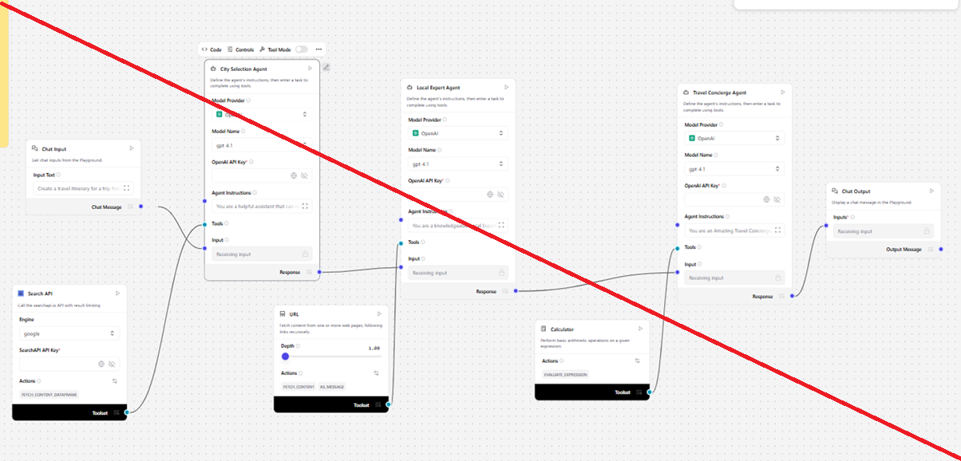
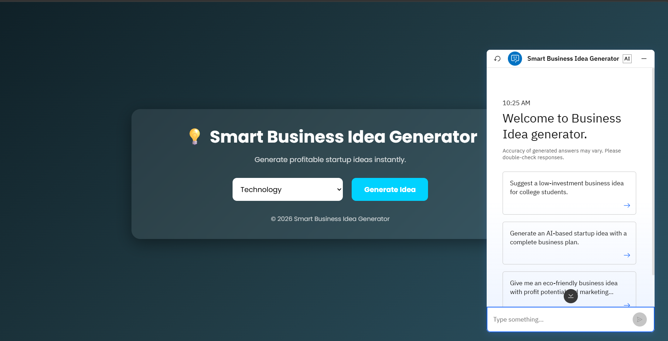
Working -

Slide 8

Role of Agentic AI in the solution
Role of Agentic AI in the Smart Business Idea Generator
Agentic AI acts as the intelligent decision-making engine of the Smart Business Idea Generator. Unlike a traditional AI model that only answers questions, Agentic AI can understand user goals, plan multiple steps, retrieve relevant business knowledge, reason over the information, and generate personalized business recommendations. It coordinates different components such as the AI model, retrieval system, and knowledge base to provide accurate and context-aware startup ideas.
Key Roles of Agentic AI
Understands User Requirements: Analyzes the user's business interests, investment budget, skills, target market, and preferences to determine the most suitable business opportunities.
Plans the Workflow: Decides the sequence of actions required to answer the user's request, such as retrieving market information, querying the knowledge base, and generating business ideas.
Retrieves Relevant Information: Uses Retrieval-Augmented Generation (RAG) to search business documents, startup case studies, and market trends from the vector database before generating a response.
Generates Personalized Business Ideas: Utilizes the IBM Granite model to produce innovative and customized business ideas based on the user's requirements and retrieved context.

Slide 9
Git Hub Link
Please create public github repository (Enable Add README button while creating repository) with format –
Please test and Paste the working Github URL – https://github.com/atharvnalwade-oss/smart-business-idea
Make sure you have Uploaded following three files into your github repository 1) app.json file , 2) yourproblemstatement.pdf file 3) your projectpresntation.pptx file 4)any other files
·
·
·

Slide 10
Novelty and Uniqueness
Novelty
The Smart Business Idea Generator is a novel AI-powered application that goes beyond traditional business idea generators by using Agentic AI, IBM watsonx.ai, IBM Granite models, and Retrieval-Augmented Generation (RAG). Instead of displaying a fixed list of business ideas, the system intelligently understands the user's requirements, retrieves relevant business knowledge, reasons over the information, and generates personalized startup recommendations.
The integration of AI reasoning with real-time knowledge retrieval ensures that users receive practical, context-aware, and innovative business ideas tailored to their interests, skills, investment capacity, and market trends.
Uniqueness
Agentic AI-Based Decision Making: Uses Agentic AI to understand user goals, plan the workflow, retrieve knowledge, and generate intelligent business recommendations.
Personalized Business Ideas: Generates customized startup ideas based on user preferences such as industry, investment budget, skills, and target audience instead of providing generic suggestions.
IBM Granite Large Language Model: Leverages IBM Granite foundation models for advanced natural language understanding, reasoning, and high-quality business idea generation.
RAG-Enhanced Responses: Combines Retrieval-Augmented Generation (RAG) with a vector database to retrieve relevant business information before generating responses, improving accuracy and reducing AI hallucinations.
Context-Aware Recommendations: Suggests not only business ideas but also investment estimates, target customers, revenue models, implementation steps, and growth opportunities.
Visual AI Workflow with Langflow: Uses Langflow to create a modular and easily maintainable AI workflow by integrating multiple AI components without complex coding.

Slide 11
Future Scope
1. AI-Based Business Plan Generation
The system can automatically generate complete business plans, including executive summaries, market analysis, financial projections, marketing strategies, and operational plans based on the selected business idea.
2. Real-Time Market Trend Analysis
By integrating live market data, news, and industry reports, the application can recommend business ideas based on current market demand, emerging technologies, and consumer trends.
3. Financial Feasibility Analysis
Future versions can estimate startup costs, expected revenue, profit margins, break-even points, and return on investment (ROI), helping users evaluate the financial viability of their business ideas.
4. Competitor Analysis
The system can analyze existing competitors in the selected business domain and provide insights into their strengths, weaknesses, pricing strategies, and market positioning.
·
·
·

Slide 12
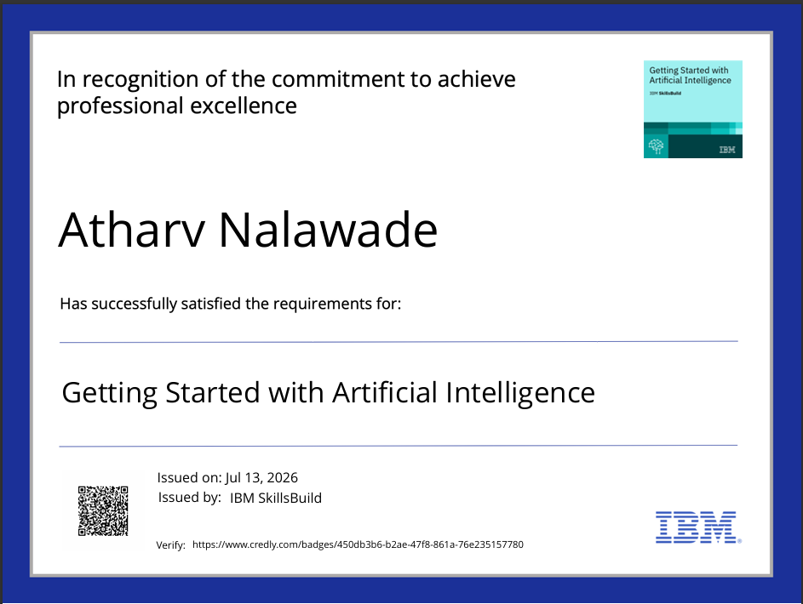
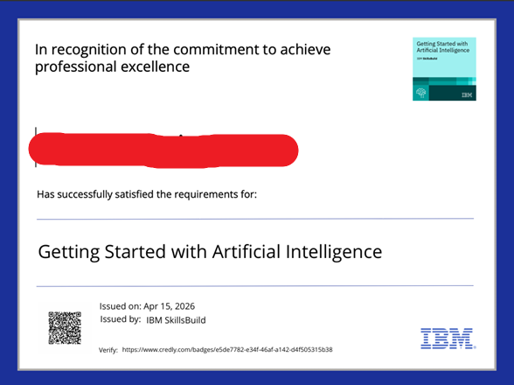
Certificates Earned:
Please add your credly certificate

Slide 13
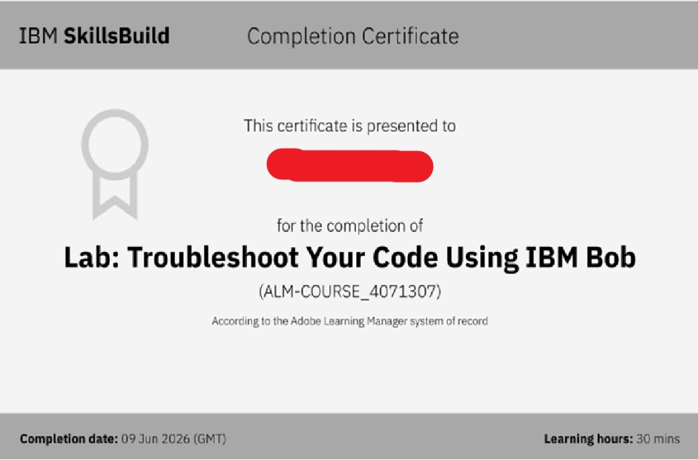
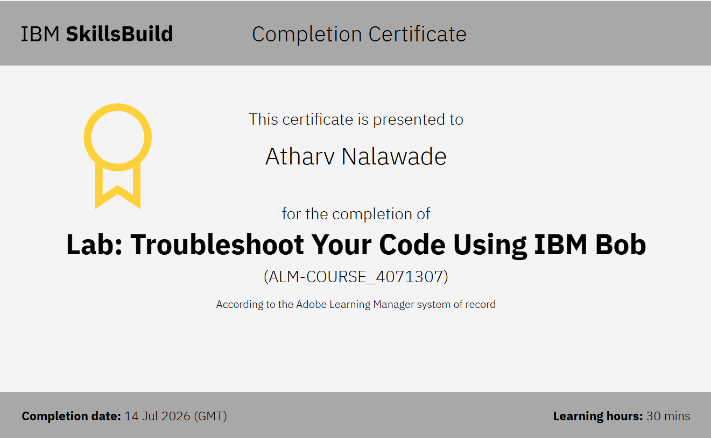
Certificates Earned:​
Add your IBM BOB Certificate

Slide 14


